Slide 1
Oxford University Biotech Society Catalyse Oxford 2022 Biohackathon

Slide 2
Catalyse Oxford
Team formation events
Workshops covering e.g., ideation, IP & legal, financial modelling and fundraising
Mentorship evening
Biohackathon with mentorship, pitching and prizes
8-week programme
January – March

Slide 3
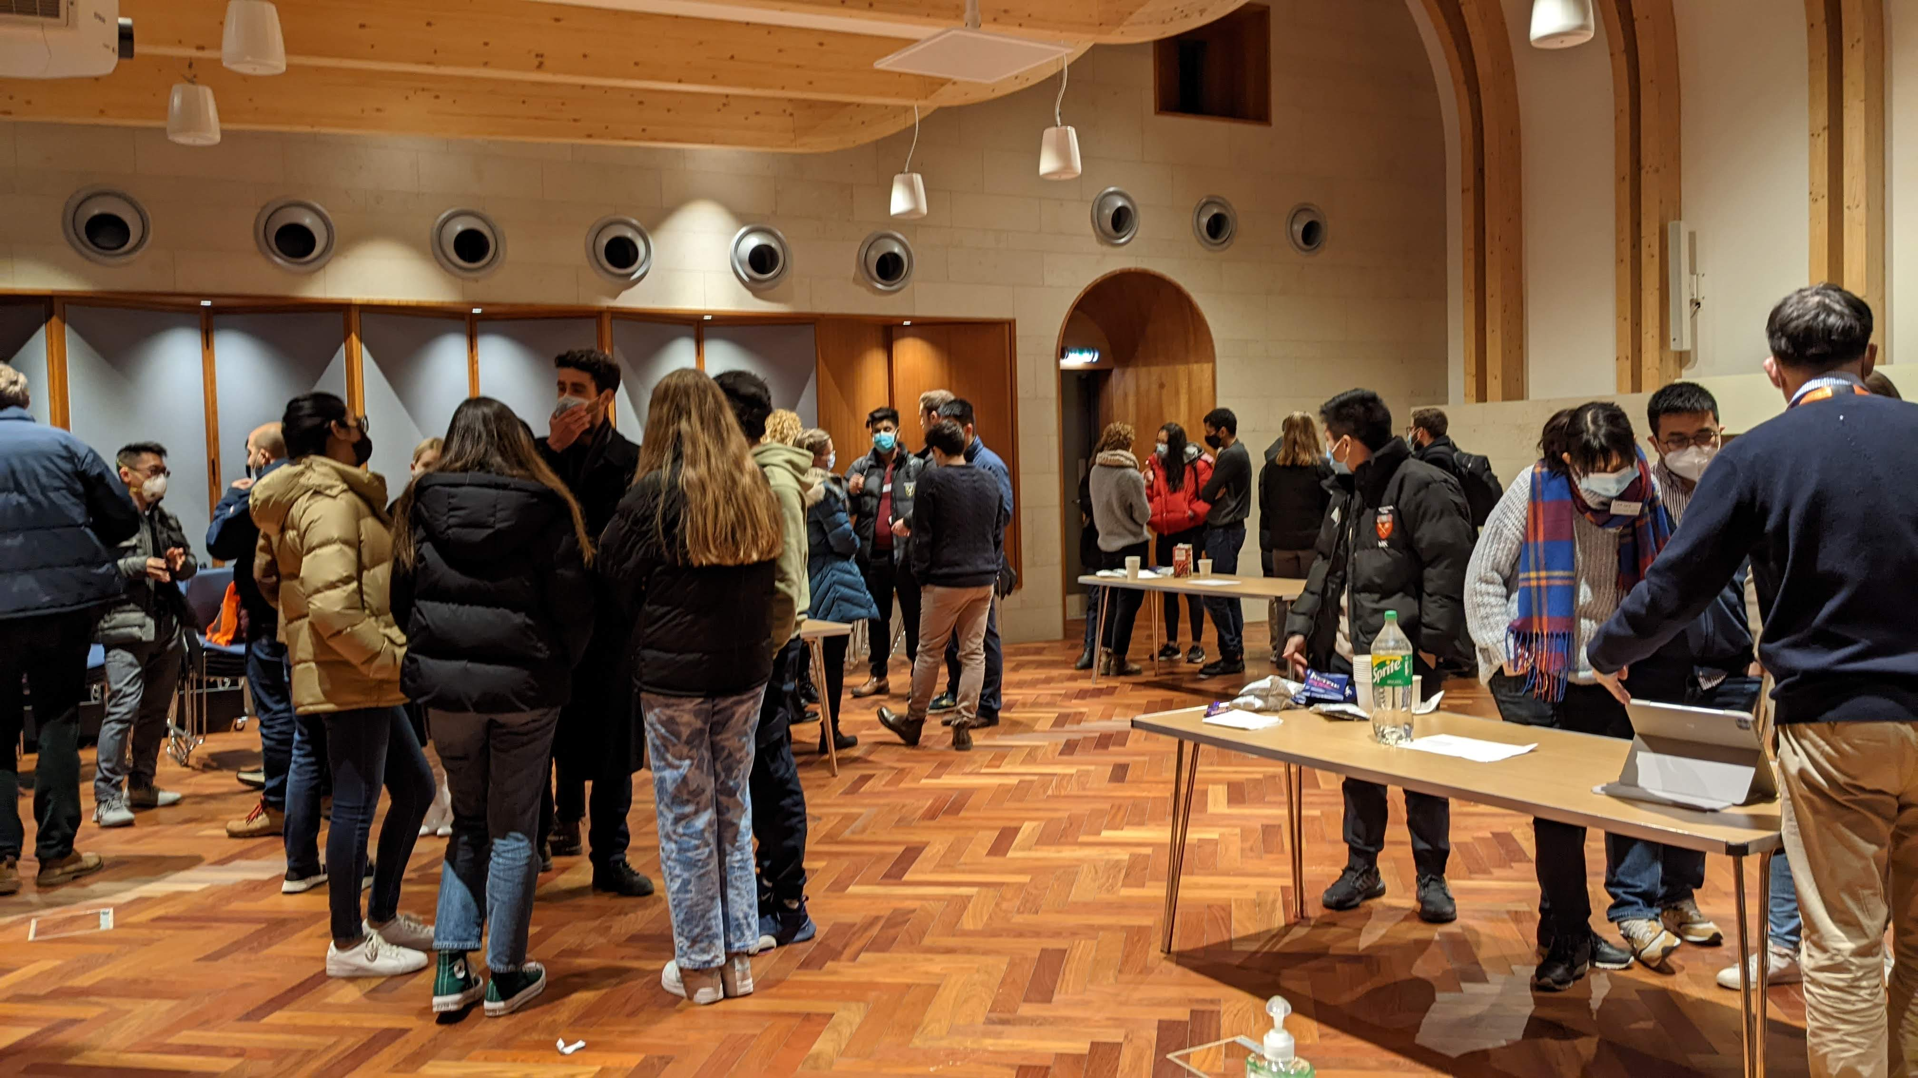
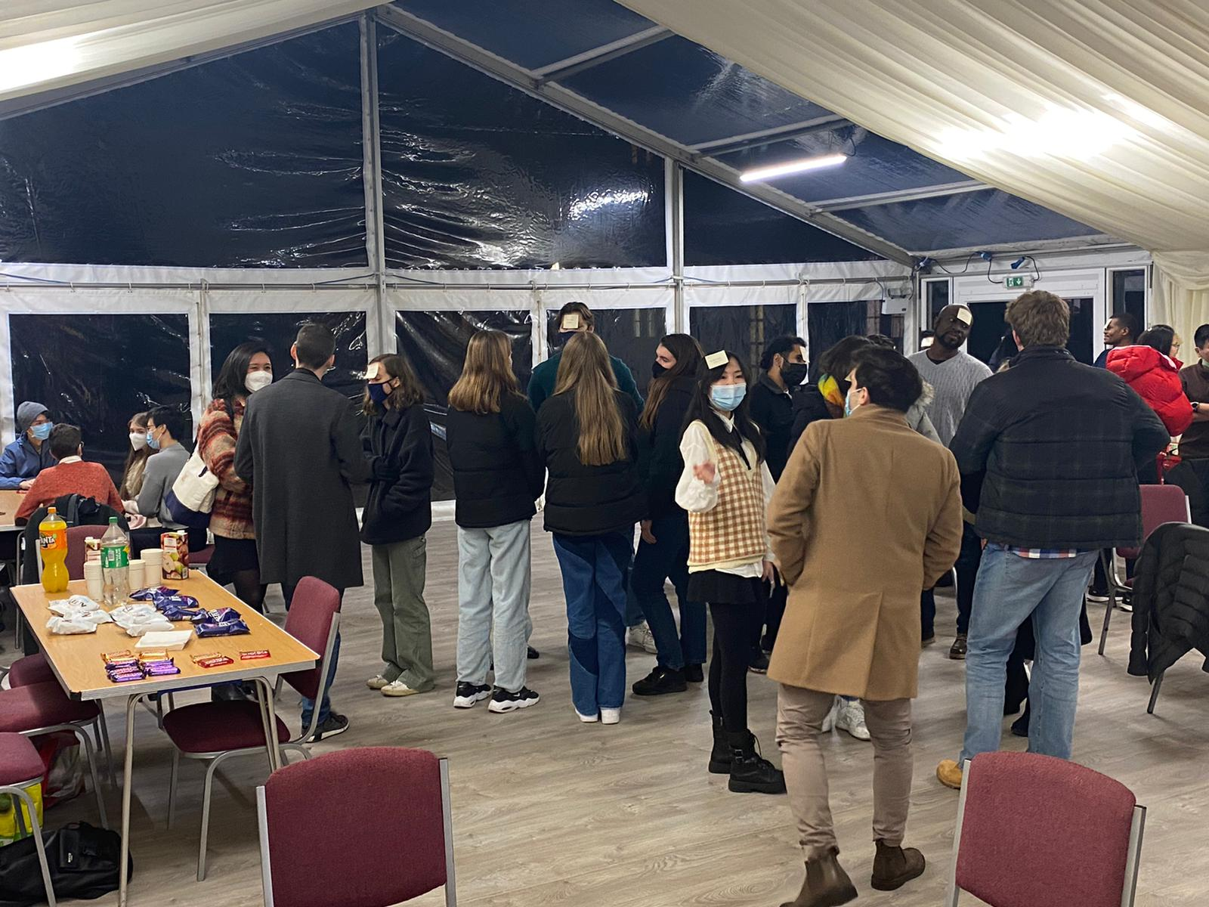
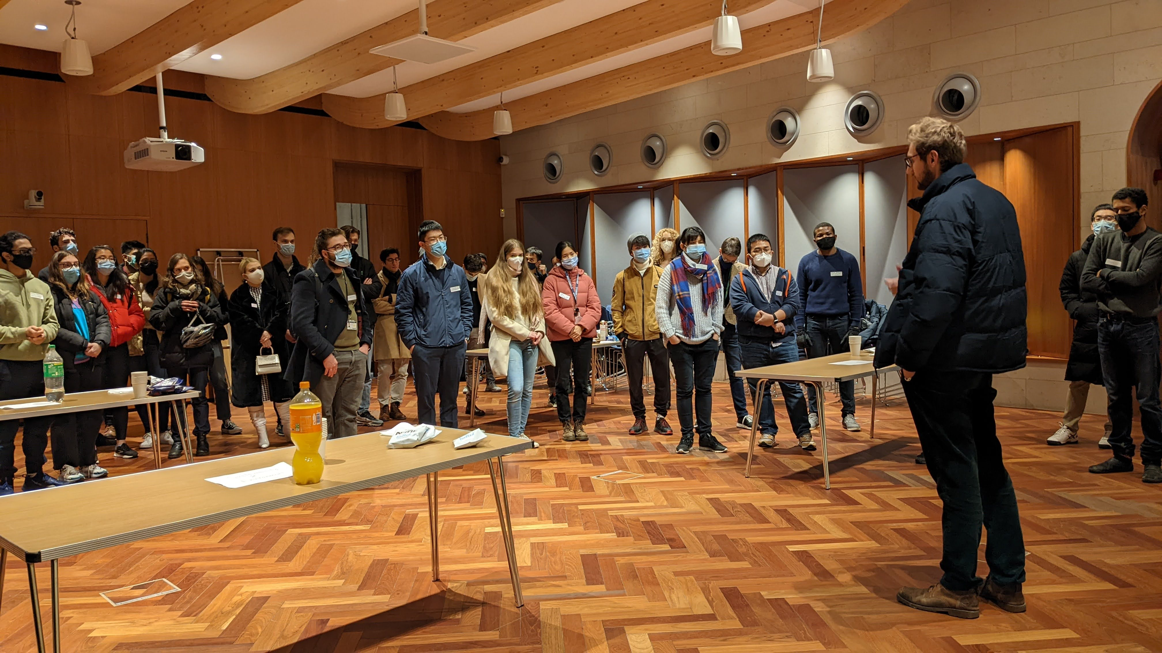
Catalyse Oxford

Slide 4
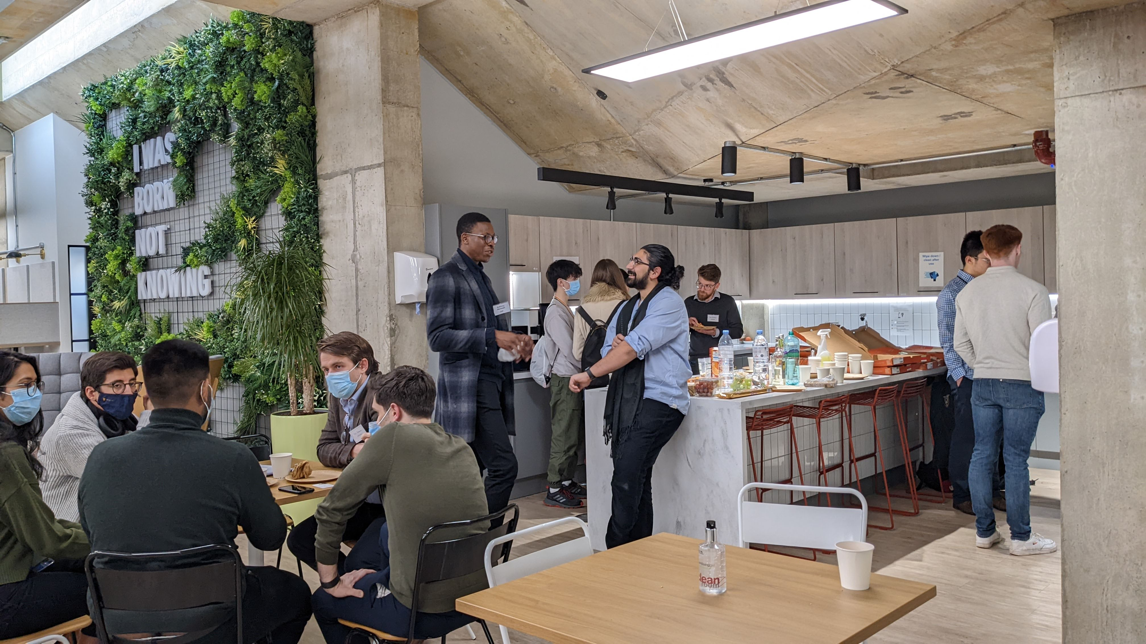
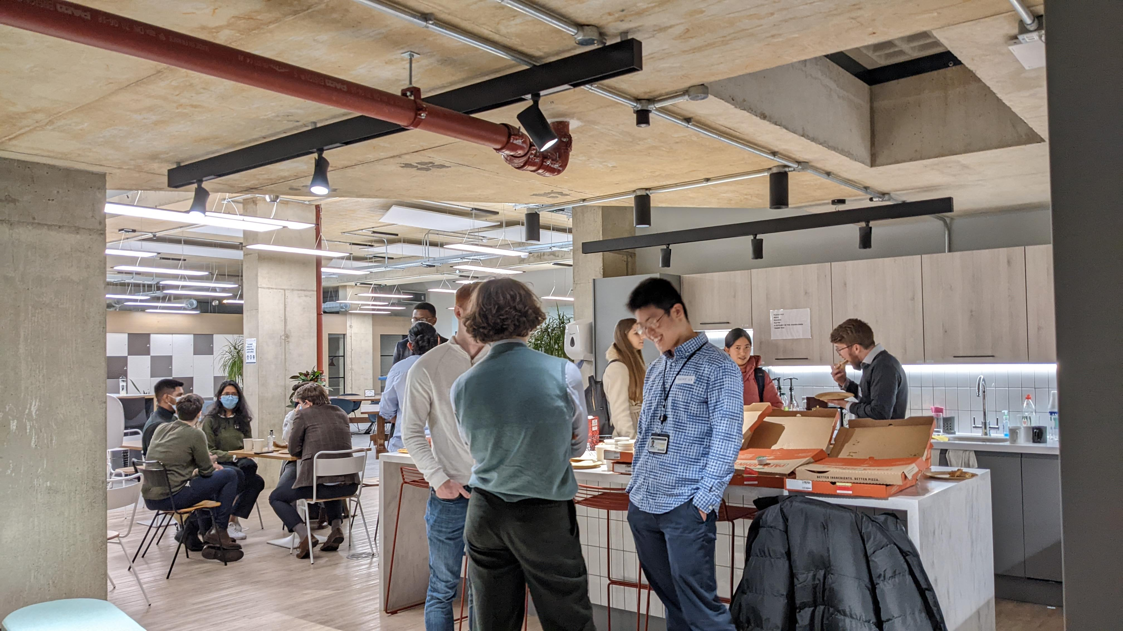
Catalyse Oxford

Slide 5
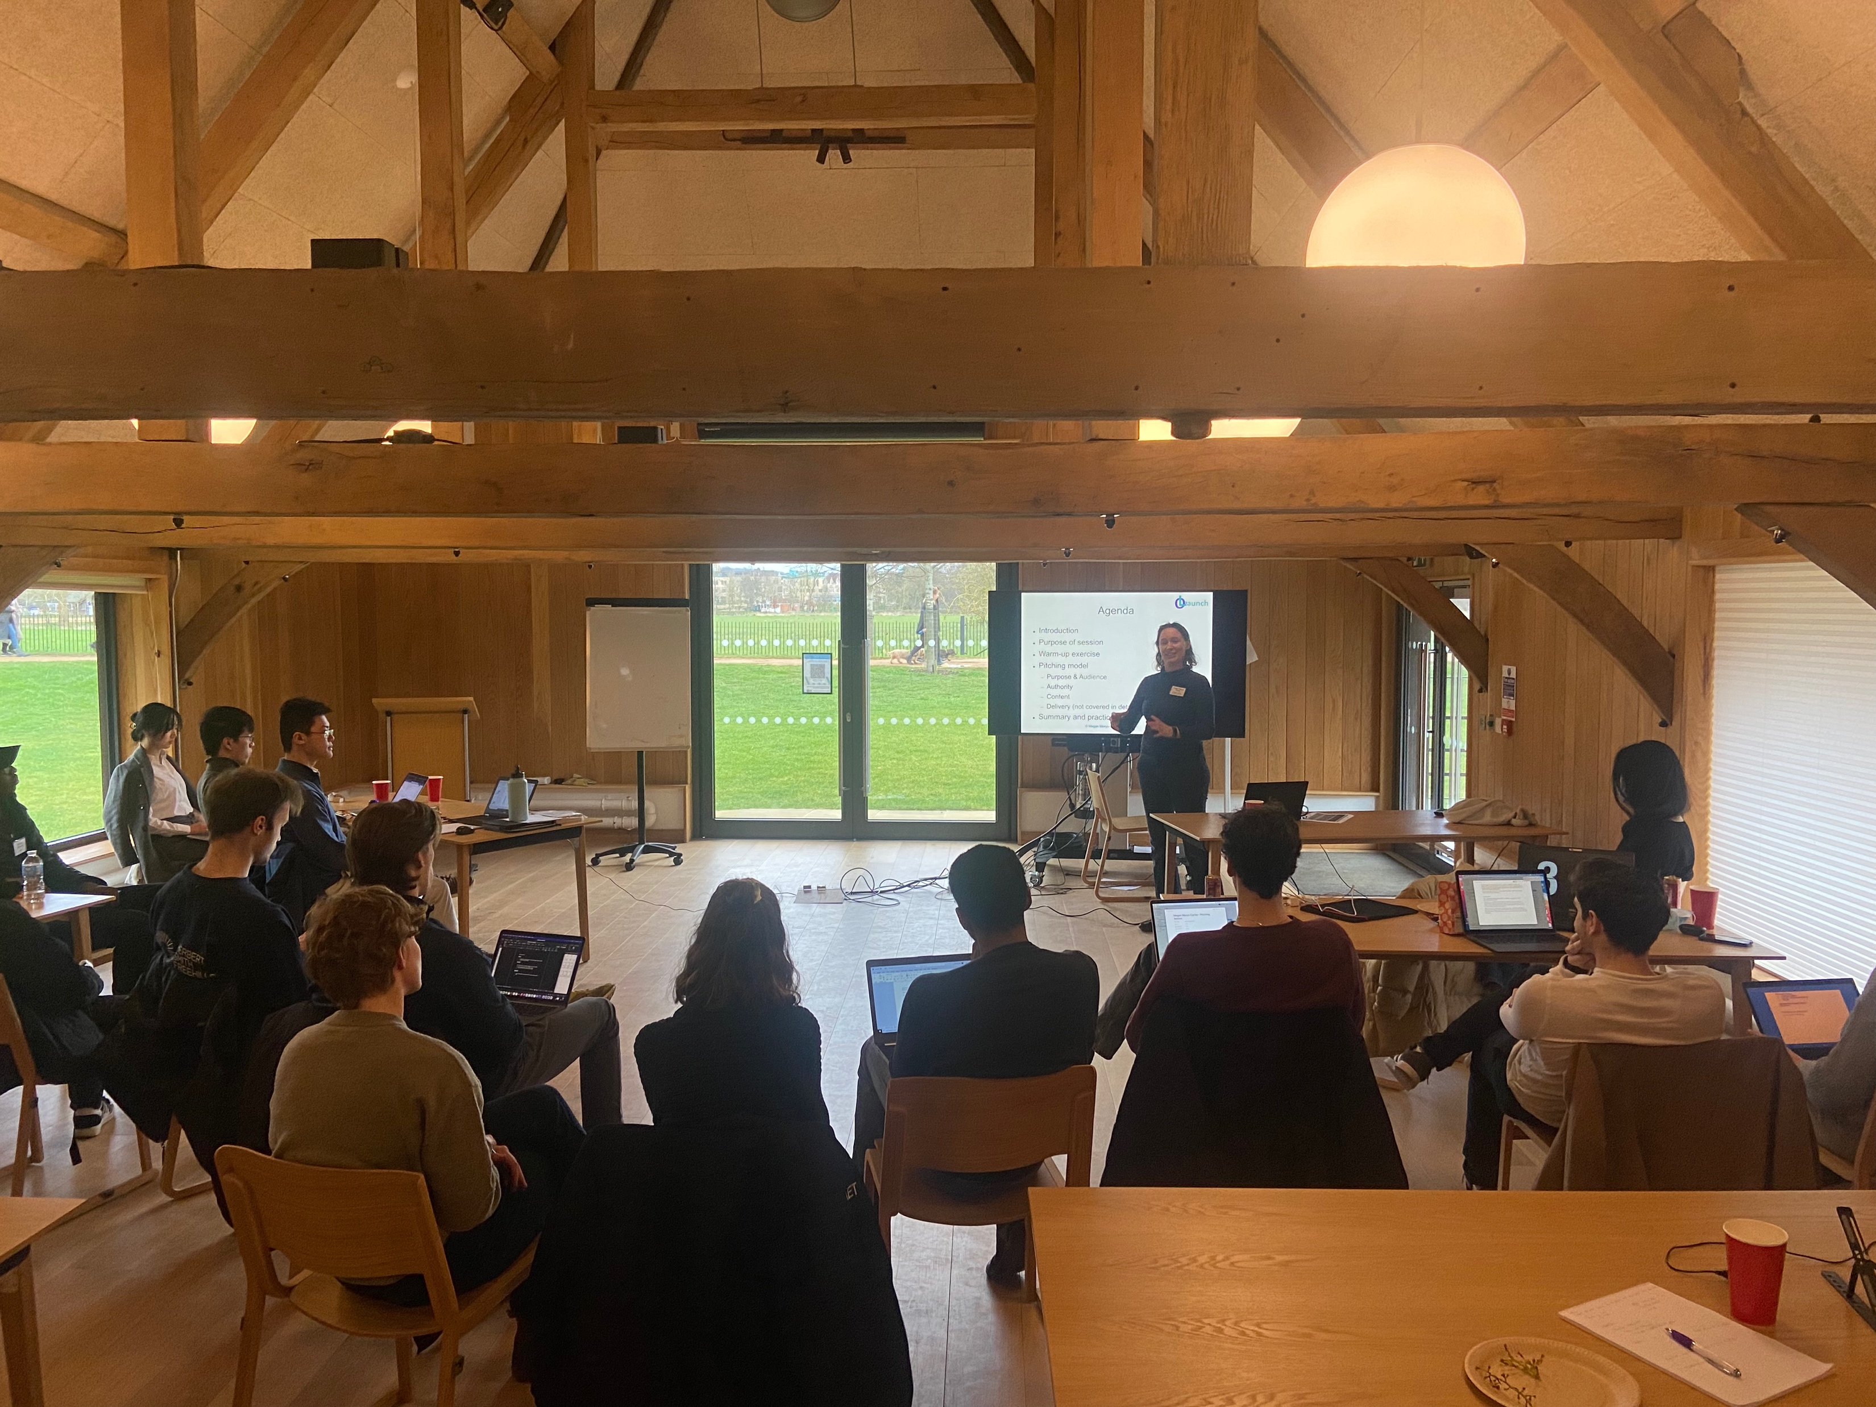
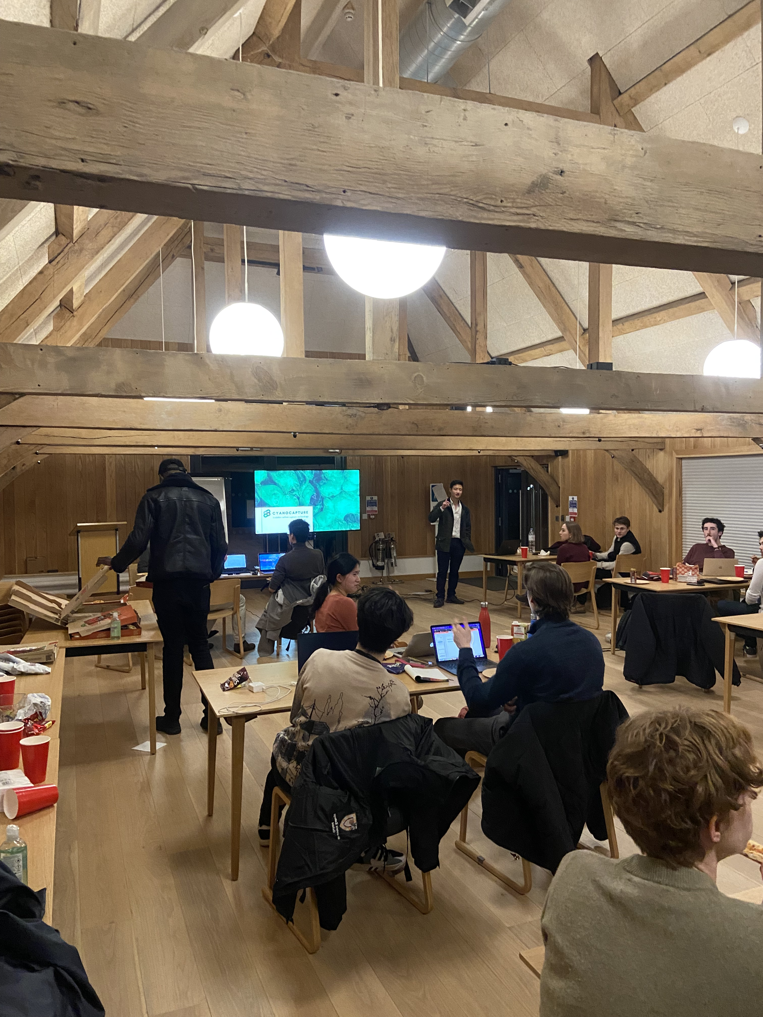
Catalyse Oxford

Slide 6
Catalyse Oxford
Miteskill
Reposition Therapeutics
Theraport
Infinitopes
Cenomics
Oishii Meat
4 min pitch +
4 min Q&A

Slide 7
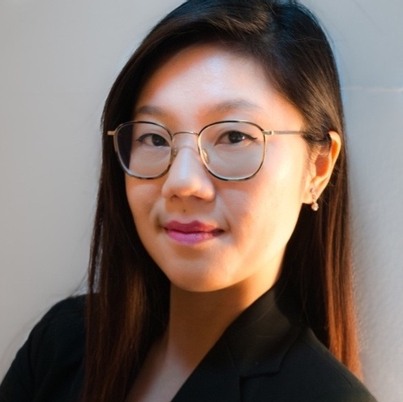
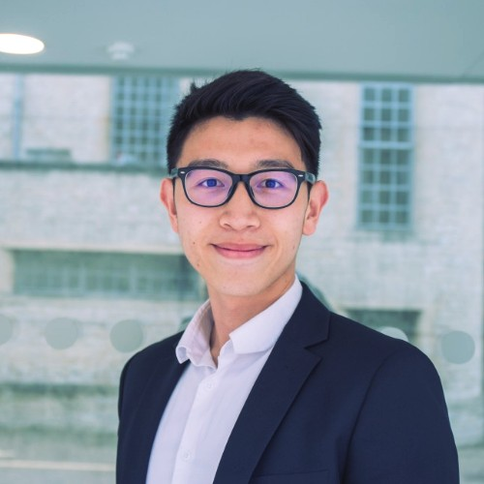
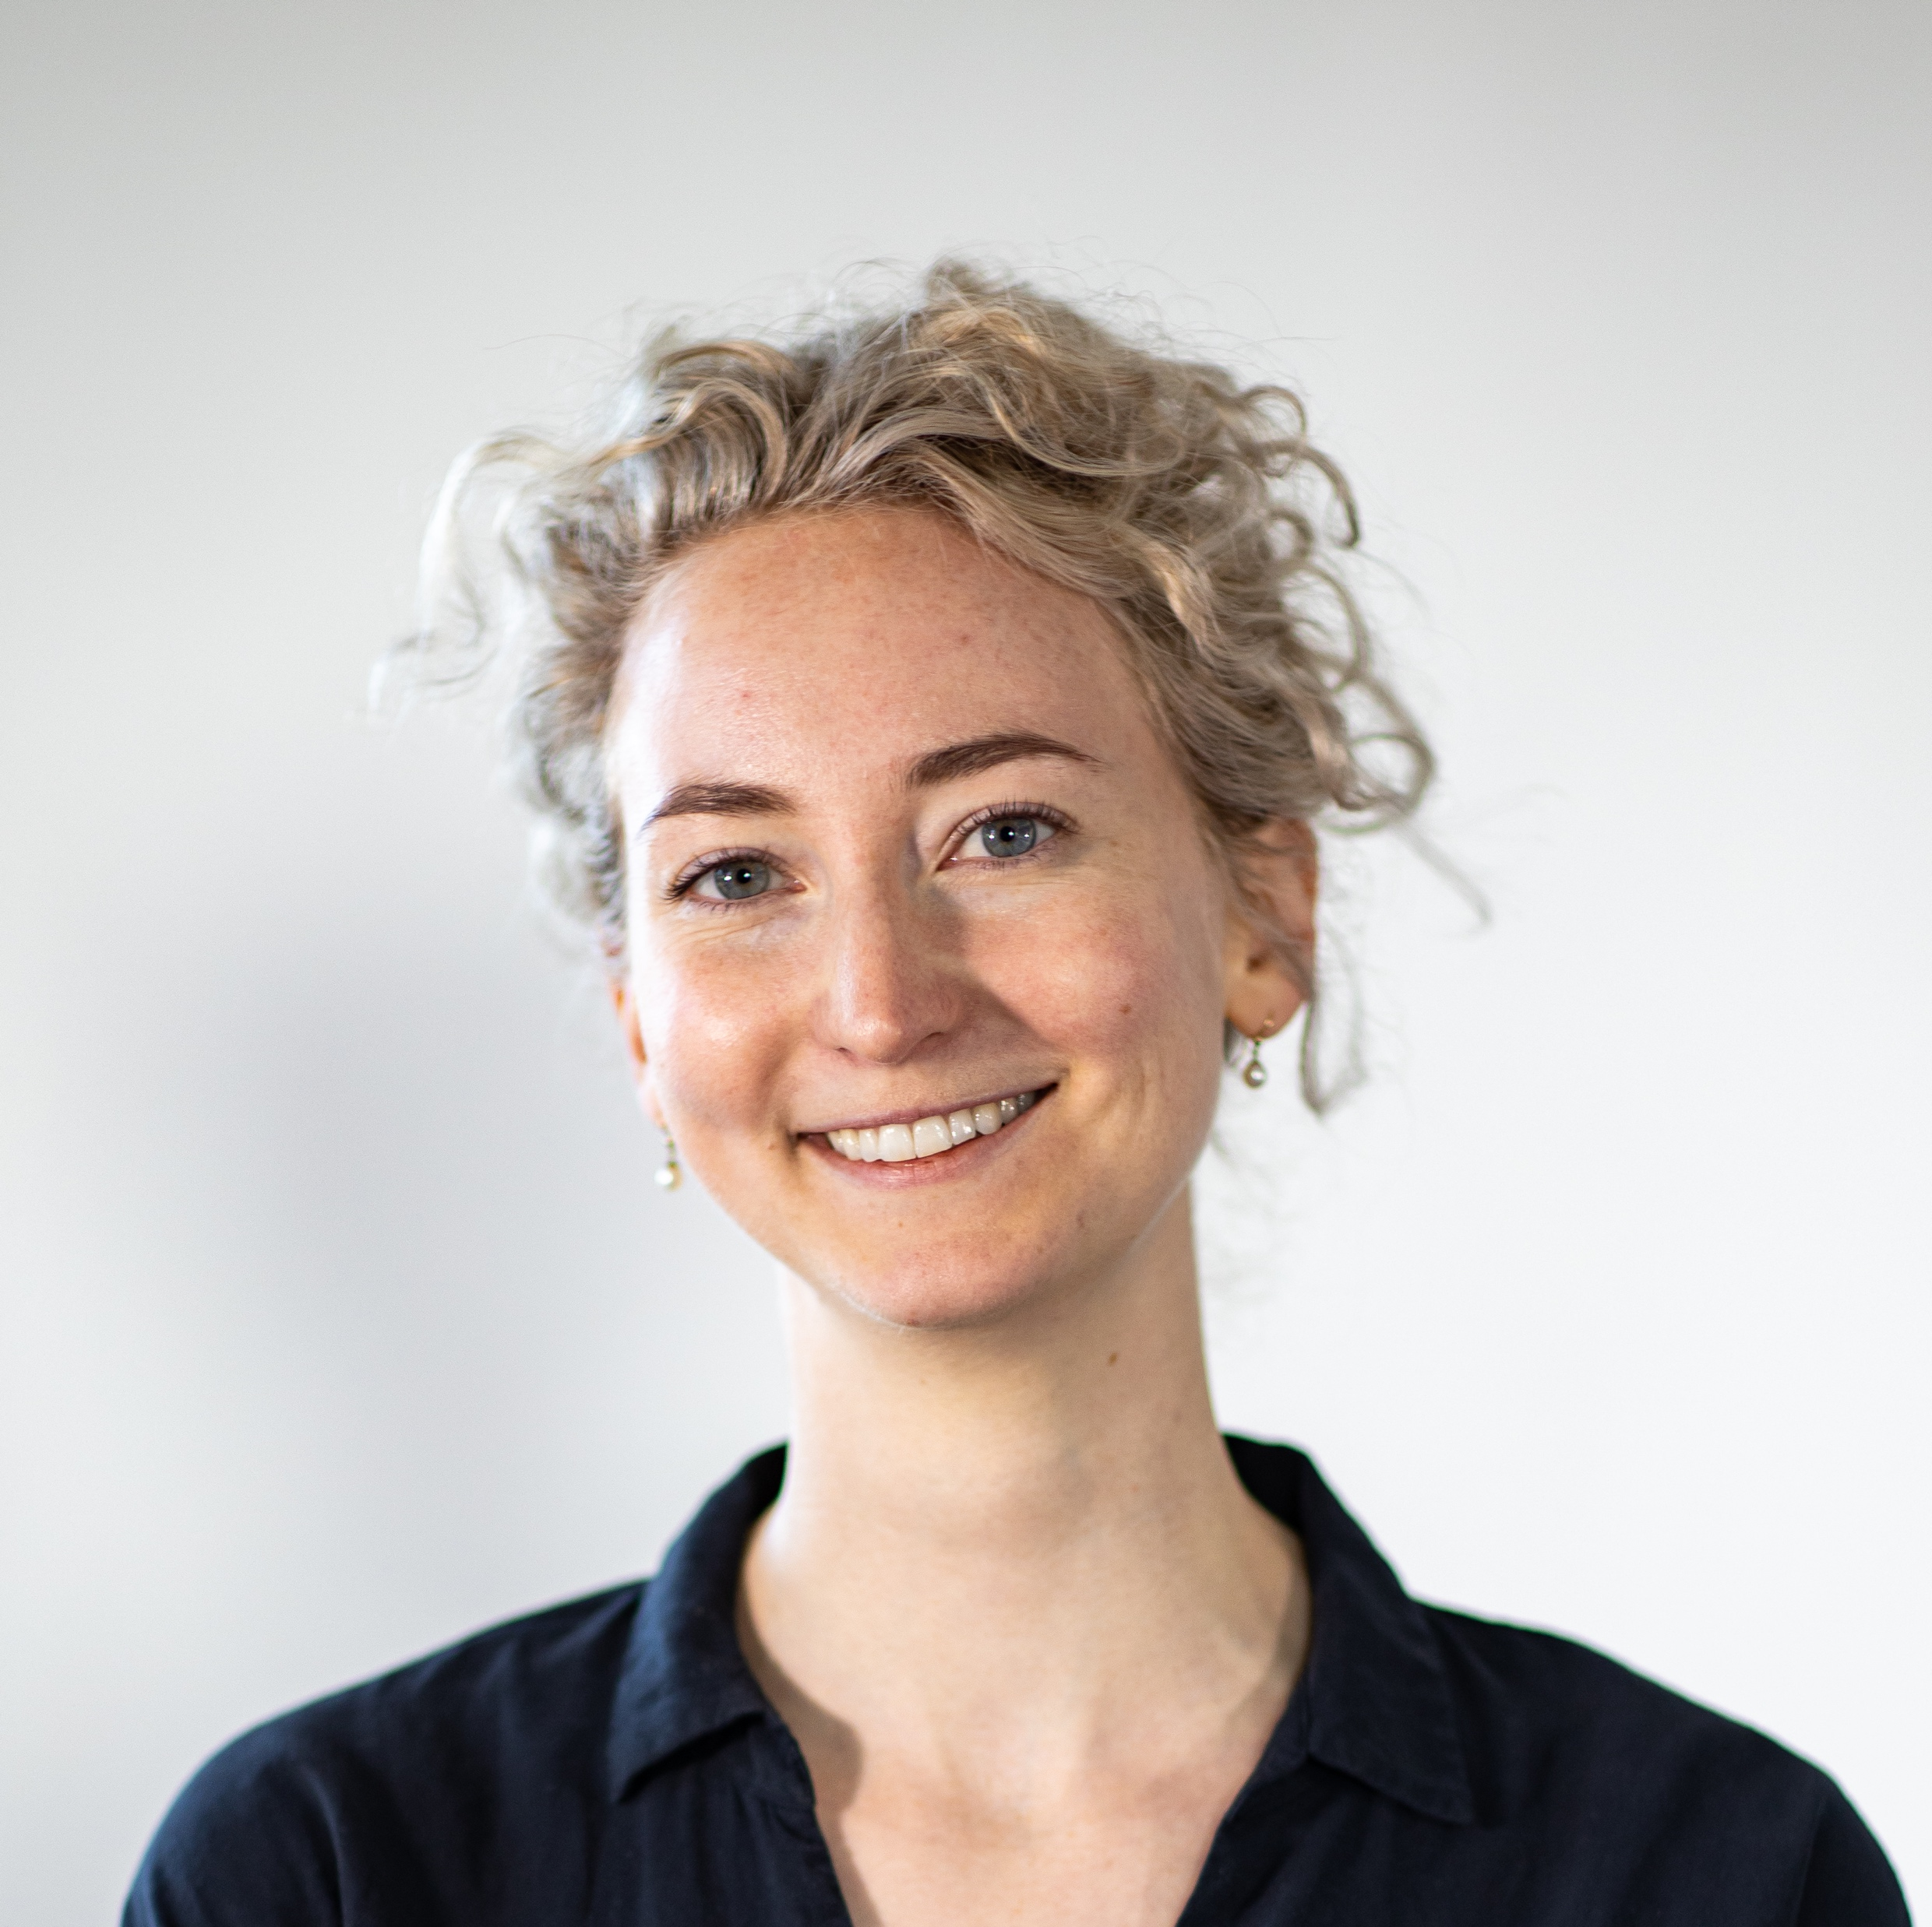
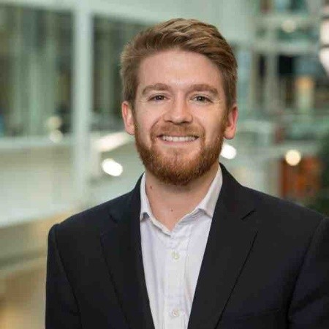
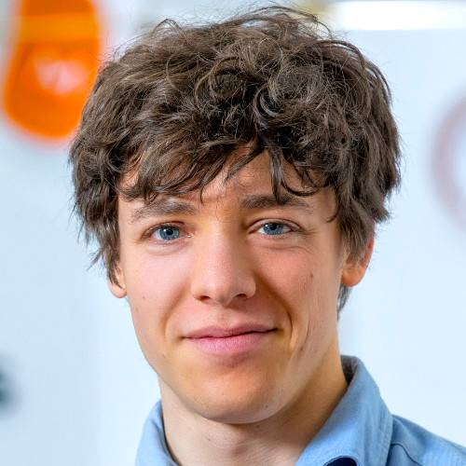
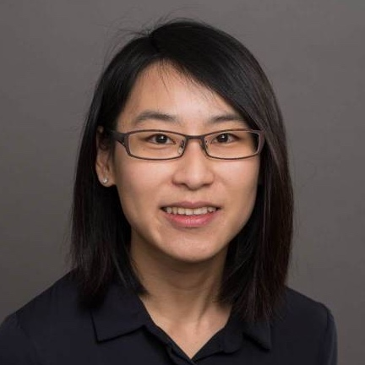
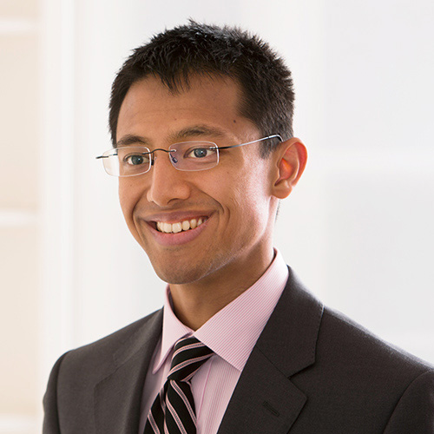
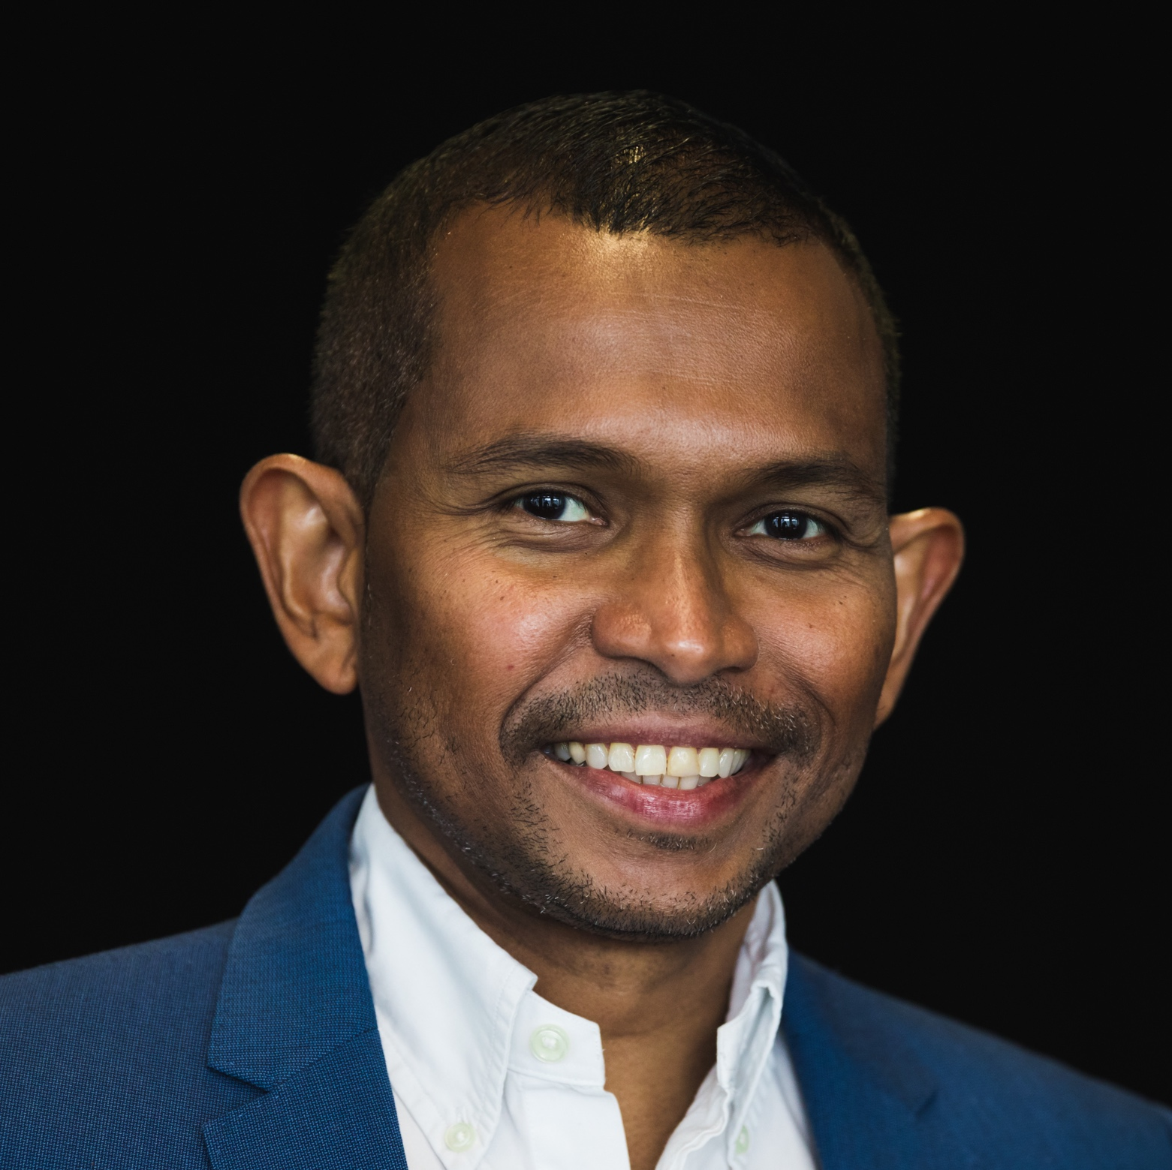
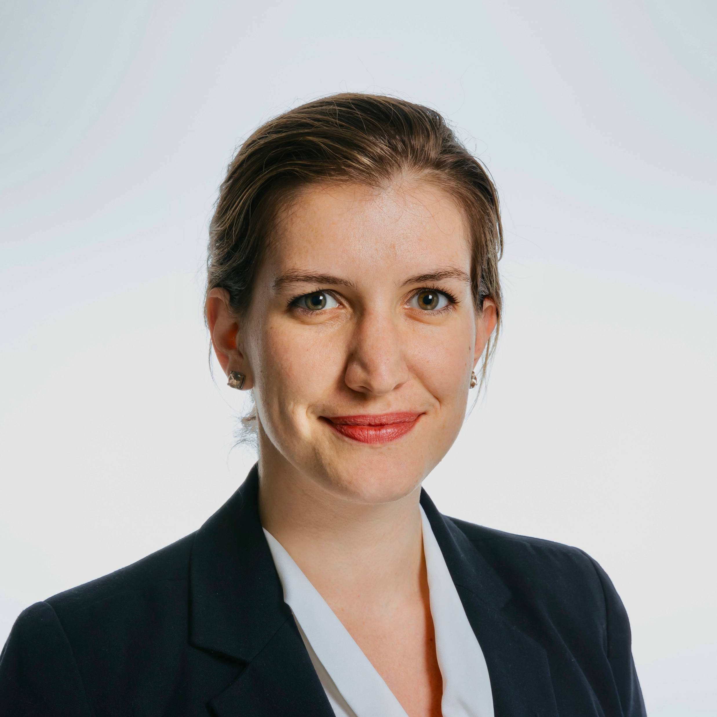
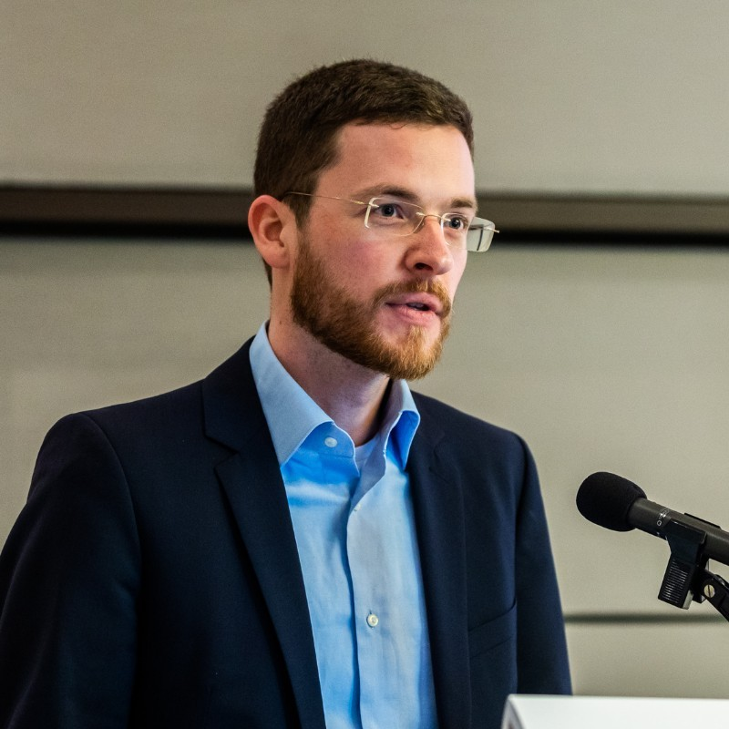
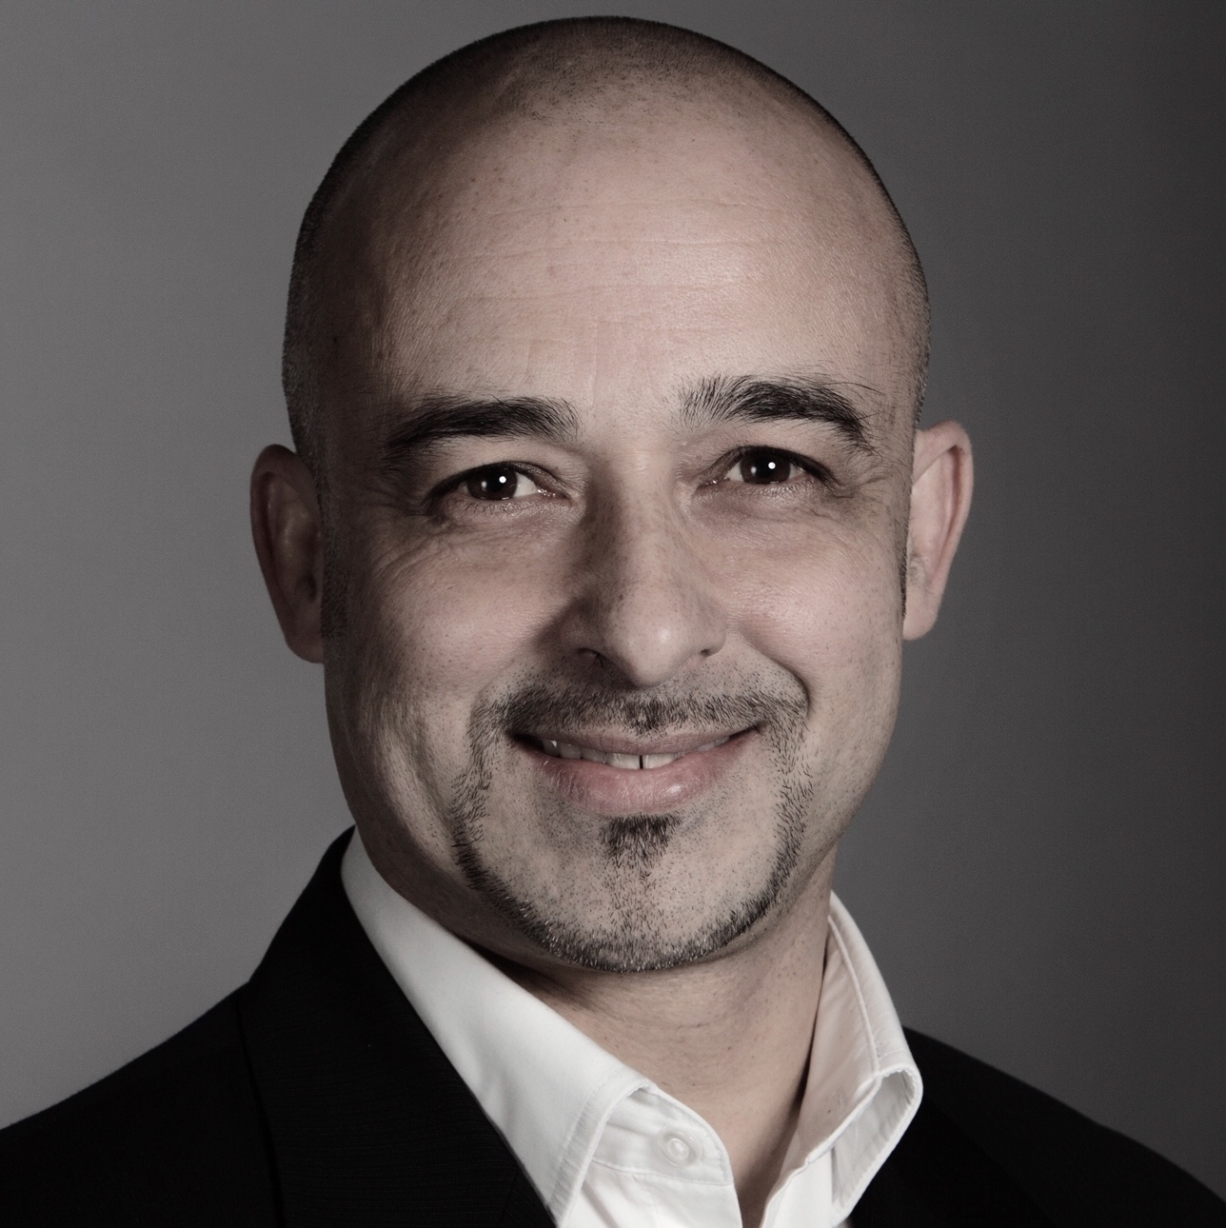
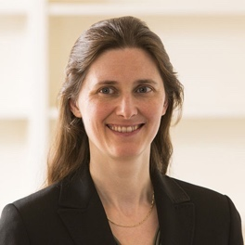
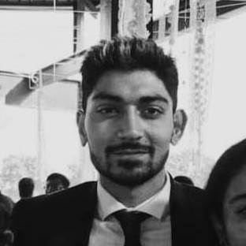
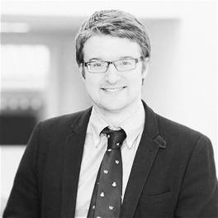
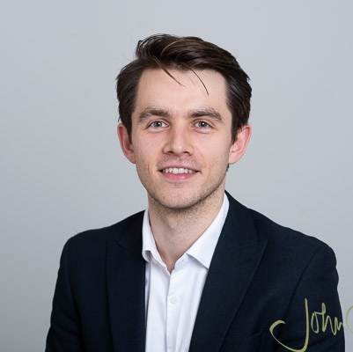
Mentors
Dr Amy Koh
Dr Boon Chuan Lim
Charlotte Casebourne
Dan Hudson
Jacob Goodwin
Dr Jane Hsu
Dr Kapil Tuladhar
Dr Lakmal Jayasinghe
Lily Elsner
Dr Martin-Immanuel Bittner
Mike Karim
Dr Nicola Kimblin
Omar Kabir
Dr Peter Crane
Phil Jakeman

Slide 8
Prizes
🏆BioEscalator Prize of 3 months lab space + £1000 consumables budget
🏆 Nanopore Grand Prize of £2000
🏆 Nanopore Runner-Up Prize of £1000

Slide 9
Thank you to our sponsors!

Slide 10
Judges
Dr Carolyn Porter – CEO, CytoSeek
Dr Claire Shingler – Business Manager, BioEscalator
Devika Thapar – Co-Founder and COO, Wilbe
Dr Sally Dewhurst – Life Sciences Associate, Oxford Science Enterprises

